Slide 1
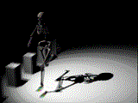
Foundations of Kinesiology!

Slide 2
Kinesiology
Kinesiology - study of motion or human movement
Anatomic kinesiology - study of human musculoskeletal system & musculotendinous system

Slide 3
Kinesiology
Structural kinesiology - study of muscles as they are involved in science of movement
Both skeletal & muscular structures are involved
Bones are different sizes & shapes − particularly at the joints, which allow or limit movement

Slide 4
Kinesiology
Muscles vary greatly in size, shape, & structure from one part of body to another
More than 600 muscles are found in human body

Slide 5
Why Kinesiology?
Through kinesiology & analysis of skills, physical educators can understand & improve specific aspects of physical conditioning

Slide 6
Reference positions
Basis from which to describe joint movements
Anatomical position
Fundamental position

Slide 7
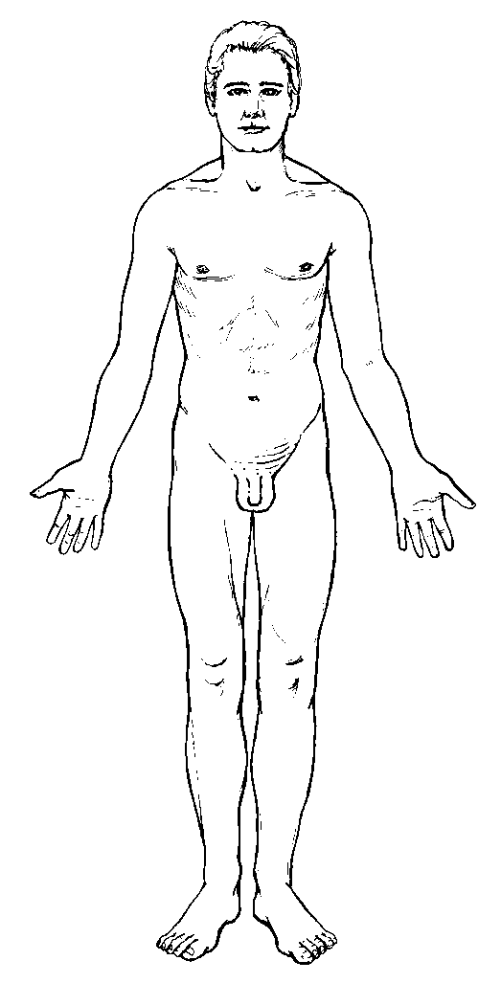
Reference positions
Anatomical position
most widely used & accurate for all aspects of the body
standing in an upright posture, facing straight ahead, feet parallel and close, & palms facing forward
Fundamental position
is essentially same as anatomical position except arms are at the sides & palms facing the body

Slide 8
Anatomical directional terminology
Anterior
in front or in the front part
Anteroinferior
in front & below
Anterosuperior
in front & above
Posterior
behind, in back, or in the rear
Posteroinferior
behind & below; in back & below
Posterolateral
behind & to one side, specifically to the outside

Slide 9
Anatomical directional terminology
From Van De Graaff KM: Human anatomy, ed 6, New York, 2002, McGraw-Hill

Slide 10
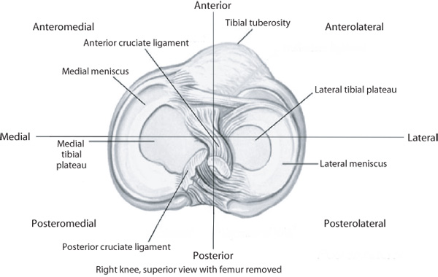
Anatomical Directional Terminology
Anterolateral
in front & to the side, especially the outside
Anteromedial
in front & toward the inner side or midline
Anteroposterior
relating to both
front & rear
Posteromedial
behind & to the inner side
Posterosuperior
behind & at the upper part

Slide 11
Anatomical directional terminology
Contralateral
pertaining or relating to the opposite side
Ipsilateral
on the same side
Bilateral
relating to the right and left sides of the body or of a body structure such as the right & left extremities

Slide 12
Anatomical directional terminology
Inferior (infra)
below in relation to another structure; caudal
Superior (supra)
above in relation to another structure; higher, cephalic
Distal
situated away from the center or midline of the body, or away from the point of origin
Proximal
nearest the trunk or the point of origin
Lateral
on or to the side; outside, farther from the median or midsagittal plane
Medial
relating to the middle or center; nearer to the medial or midsagittal plane
Median
Relating to the middle or center; nearer to the median or midsagittal plane
From Van De Graaff KM: Human anatomy, ed 6, New York, 2002, McGraw-Hill

Slide 13
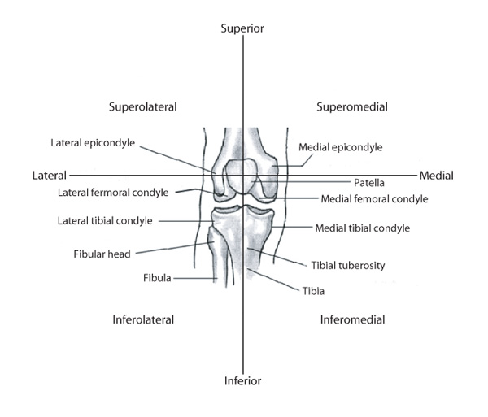
Anatomical directional terminology
Inferolateral
below & to the outside
Inferomedial
below & toward the midline or inside
Superolateral
above & to the outside
Superomedial
above & toward the midline or inside

Slide 14
Anatomical directional terminology
Caudal
below in relation to another structure; inferior
Cephalic
above in relation to another structure; higher, superior

Slide 15
Anatomical directional terminology
Deep
beneath or below the surface; used to describe relative depth or location of muscles or tissue
Superficial
near the surface; used to describe relative depth or location of muscles or tissue

Slide 16
Anatomical directional terminology
Prone
the body lying face downward; stomach lying
Supine
lying on the back; face upward position of the body

Slide 17
Anatomical directional terminology
Dorsal
relating to the back; being or located near, on, or toward the back, posterior part, or upper surface of
Ventral
relating to the belly or abdomen, on or toward the front, anterior part of

Slide 18
Anatomical directional terminology
Volar
relating to palm of the hand
Plantar
relating to the sole or undersurface of the foot

Slide 19
Articular System
Series of joints that allows movement
Combined with neuromuscular system, enables locomotion
Joint articulation
Formed when two bones come into contact
Can be freely movable
Arthrology
Study of joints

Slide 20
Classification of Joints
Synarthroses
Joints that lack a synovial cavity
Held closely together by fibrous connective tissue
Immovable
Three structural types
Sutures
Syndesmosis
Gomphosis

Slide 21
Classification of Joints (cont’d.)
Amphiarthroses
Slightly moveable
Bones are connected by hyaline cartilage or fibrocartilage

Slide 22
Classification of Joints (cont’d.)
Diarthroses or synovial joints
Freely movable
Ends of opposing bones are covered with articular cartilage
Separated by joint cavity
Components are enclosed in fibrous joint capsule

Slide 23
Movement of Diarthroses
Range of motion in movable joints varies
Synovial joints move most freely
Shoulders have the greatest range of motion
Joint stability is determined by:
Shape of the bones where they come together
Ligaments that join the bones
Muscle tone

Slide 24
Closed and Open Kinematic Chains
Closed kinematic chain
Movement or exercise at the end of the chain, farthest from the body, is fixed
In a squat feet are fixed and the rest of leg chain moves
Open kinematic chain
Movement or exercise at the end of the chain is free
Seated leg extension

Slide 25
Planes of Motion
Imaginary two-dimensional surface through which a limb or body segment is moved
Motion through a plane revolves around an axis
There is a ninety-degree relationship between a plane of motion & its axis

Slide 26
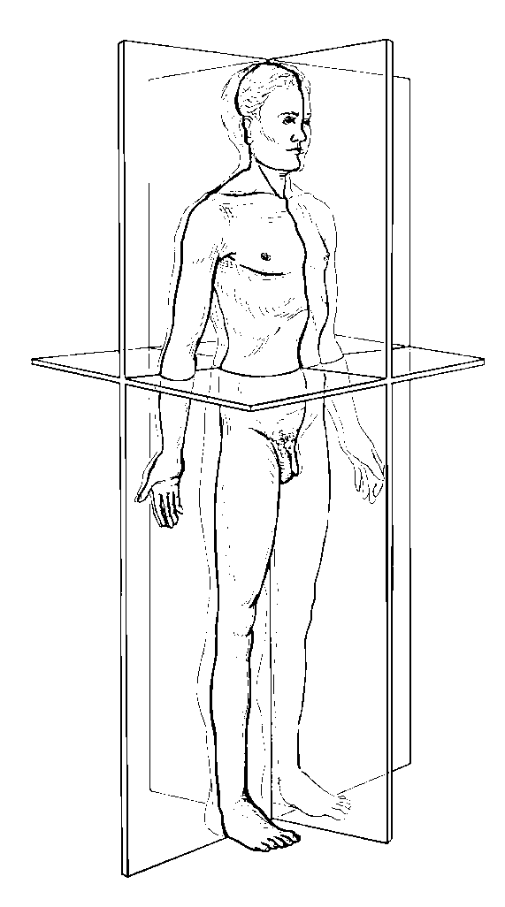
Cardinal planes of motion
3 basic or traditional
in relation to the body, not in relation to the earth
Anteroposterior or Sagittal Plane
Lateral or Frontal Plane
Transverse or Horizontal Plane

Slide 27
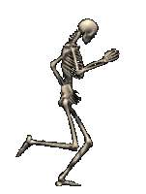
Cardinal planes of motion
Anteroposterior or Sagittal Plane(midsagittal)
divides body into equal, bilateral segments
It bisects body into 2 equal symmetrical halves or a right & left half
Ex. Sit-up

Slide 28
Cardinal planes of motion
Lateral or Frontal Plane
divides the body into (front) anterior & (back) posterior halves
Ex. Jumping Jacks

Slide 29
Cardinal planes of motion
Transverse or Horizontal Plane
divides body into (top) superior & (bottom) inferior halves when the individual is in anatomic position
Ex. Spinal rotation to left or right

Slide 30
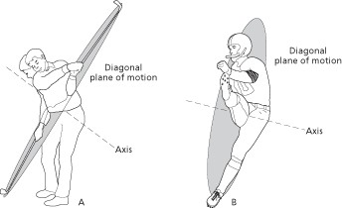
Diagonal Planes of Motion
High Diagonal
Low Diagonal
Low Diagonal

Slide 31
Axes of Rotation
For movement to occur in a plane, it must turn or rotate about an axis as referred to previously
The axes are named in relation to their orientation

Slide 32
Axes of rotation
Frontal, lateral, or coronal axis
Has same orientation as frontal plane of motion & runs from side to side at a right angle to sagittal plane of motion
Runs medial / lateral
Commonly includes flexion, extension movements
Modified from Booher JM, Thibodeau GA: Athletic injury assessment, ed 4, New York, 2000, McGraw-Hill

Slide 33
Axes of rotation
Sagittal or anteroposterior axis
Has same orientation as sagittal plane of motion & runs from front to back at a right angle to frontal plane of motion
Runs anterior / posterior
Commonly includes abduction, adduction movements
Modified from Booher JM, Thibodeau GA: Athletic injury assessment, ed 4, New York, 2000, McGraw-Hill

Slide 34
Axes of rotation
Long or vertical axis
Runs straight down through top of head & is at a right angle to transverse plane of motion
Runs superior/ inferior
Commonly includes internal rotation, external rotation movements
Modified from Booher JM, Thibodeau GA: Athletic injury assessment, ed 4, New York, 2000, McGraw-Hill

Slide 35
Axes of rotation
Diagonal or oblique axis
also known as the oblique axis
runs at a right angle to the diagonal plane

Slide 36
Movements in Joints
Several different movements possible
Some joints having limited motion while others permit a wide variety of movements.
Measured using a goniometer
Hypermobile
Hypomobile

Slide 37
General Movements
Abduction: lateral movement away from the midline
Adduction: movement medially toward the midline
Flexion: bending movement that results in decreased angles of the joint by bringing bones together
Extension: Straightening movement that results in an increase in the angle of a joint
Circumduction: arc like motion (flexion, extension, add, abd)
Diagonal Abduction: movement through a diagonal plane away from the midline
Diagonal Adduction: movement through a diagonal plan toward the midline
External Rotation: movement on the vertical axis away from the body
Internal Rotation: movement on the vertical axis toward the body

Slide 38
Ankle and Foot Movements
Eversion: turning the sole of the foot outward or laterally in the frontal plane; abduction
Inversion: turning the sole of the foot inward or medially in the frontal plane; adduction
Dorsal Flexion (Dorsiflexion): flexion movement of the ankle that results in the top of the foot moving toward the tibia in the sagittal plane
Plantar Flexion: Extension movement of the ankle that results in the foot moving away from the body

Slide 39
Radiounlnar Joint
Pronation: palm down position of the the forearm
Supination: palm up position of the forearm

Slide 40
Shoulder Girdle/Joint
Depression: inferior movement of the shoulder
Elevation: superior movement of the shoulder
Horizontal Abduction: horizontal movement away from the midline of the body
Horizontal Adduction: horizontal movement toward the midline of the body
Protraction: forward movement of the shoulder girdle
Retraction: backward movement of the shoulder girdle

Slide 41
Spine
Lateral Flexion: Side bending or Abduction of the spine
Reduction: Returning the spinal column to anatomical position

Slide 42
Wrist/Hand
Palmar Flexion: palms up moving the anterior portion of hand toward the anterior portion of the wrist (flexion)
Radial Flexion (radial deviation): Abduction movement of the wrist in the frontal plane
Ulnar Flexion (ulnar deviation): Adduction movement of the wrist in the frontal plane
Opposition of the thumb: Diagonal movement of the thumb across the palmar surface of the hand.

Slide 43
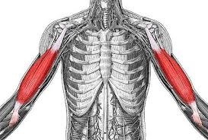
Muscle Terminology
Origin: Proximal attachment generally considered the least moveable part or the part that attaches closest to the midline or the center of the body.
Insertion: Distal attachment, generally considered the most moveable part or the part that attaches farthest from the midline or center of the body.

Slide 44
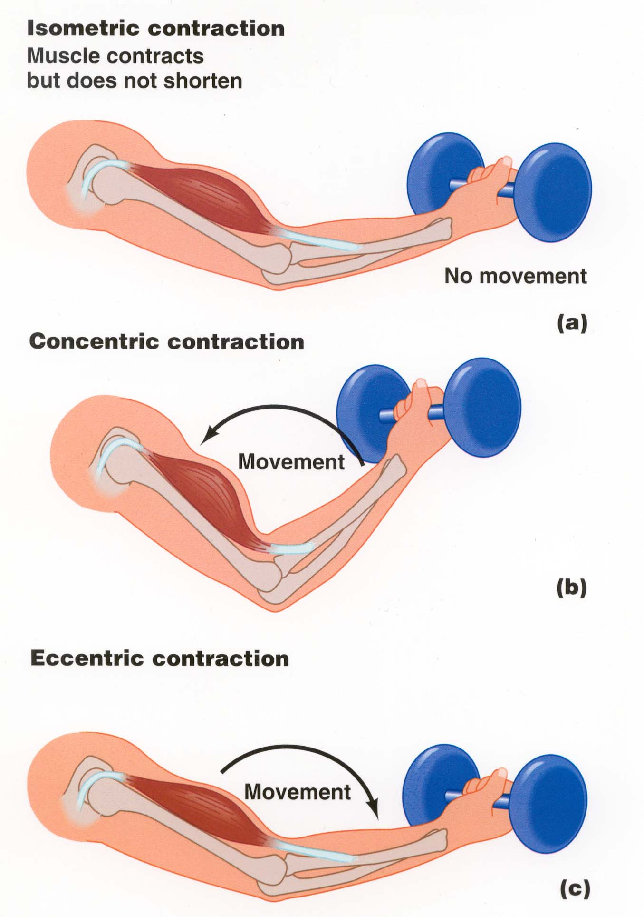
Types of Muscle Contraction
Isometric: muscle tension is developed but there is no change in the length of the muscle.
Isotonic: muscle tension while the muscle is either shortening or lengthening
Concentric: muscle developing tension as it shortens
Eccentric: muscle lengthening under tension

Slide 45
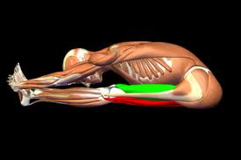
Roles of Muscles
Agonist: the primary mover; contracting concentrically
Antagonist: located opposite of the agonist; relaxes during the contraction of an agonist. Allows for increased range of motion
Stabilizer: smaller muscles that stabilize a joint while large muscle exert force on that same joint.
Synergist: muscles that assist the agonist
Neutralizers: counteract or neutralize the actions of another muscle to prevent undesirable movements
http://www.bandhayoga.com/keys_recip.html

