Slide 1
Special Considerations

Slide 2
Special Considerations in Athletics
Each athlete brings unique conditions or concerns
Important for the athletic staff to know
Range from previous injuries to potentially life-threatening allergies to bee stings
Training staff needs to be aware so they can be prepared

Slide 3
Environmental Conditions Affecting Athletes
Conditions occasionally arise that may prevent the body from maintaining homeostasis.
For example, heat and cold
Particularly damp or windy conditions
These conditions may create health problems for athletes in the course of routine practice or competitive play.

Slide 4
Environmental Heat Stress
Exertion leads to perspiration.
Perspiration (sweat) depletes the body of water, as does urination.
If eliminated fluid is not replaced, dehydration will result.
The rate at which perspiration evaporates is strongly influenced by humidity.

Slide 5
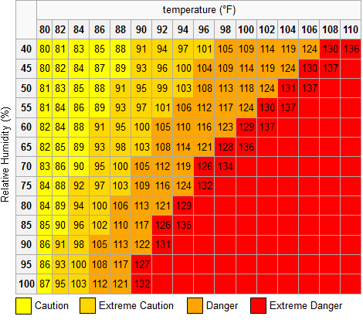
Environmental Heat Stress
Humidity is the amount of moisture that is in the air.
Relative humidity is based on the difference between the amount of water vapor in the air and the maximum amount the air could contain at the same temperature.
Used to calculate the Heat Index

Slide 6
Environmental Heat Stress
Heat Index combines air temperature and humidity to determine how hot it actually feels
A psychrometer can be used to determine the relative humidity.
Wet-bulb(WBGT)????
The calculation used measures the heat stress in direct sunlight.
This type of reading also takes into account the temperature, wind speed, humidity, the angle of the sun and the solar radiation (or simply, the cloud cover).

Slide 7
Environmental Heat Stress
Sunburn
A potential hazard for anyone who participates in outdoor activities without proper protection
Caused by ultraviolet (UV) rays from the sun
Can cause skin cancer and premature aging of the skin

Slide 8
Heat-Related Illness
A preventable sports problem
An accumulation of body heat that results when the body’s ability to cool itself is overwhelmed

Slide 9
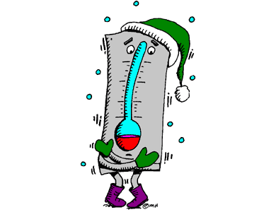
Hyperthermia
Hyperthermia – condition in which, for one reason or another, body temperature is elevated
Vitally important that the AT and the coach has a knowledge about temperature and humidity factors prior to planning workout

Slide 10
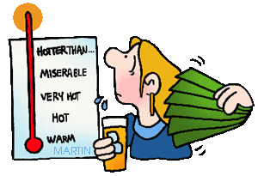
Heat Stress
Heat stress can affect everyone, regardless of the level of physical conditioning
Prolonged exposure to extreme heat can result in heat illness
Numerous deaths occur each year as a result of heat stress – it is entirely preventable
While heat related illnesses most often occur in hot, humid conditions,
it can also possibly occur
in cold conditions if dehydration
or other issues occur

Slide 11
Physiological Processes of Body
Metabolic Heat Production – the higher the metabolic rate, the more heat produced
Conductive Heat Exchange – Physical contact with other objects result in either a heat loss or heat gain (ex. Standing on hot turf or wearing a helmet)
Convective Heat Exchange – Occurs when either a mass of air or water moves around an individual (Breeze)
Radiant Heat Exchange – radiant heat from the sun causes body temp to rise
Evaporative Heat Loss – When the temp of the environment becomes higher than body temp, sweat occurs
Important to monitor sweating in certain individuals

Slide 12
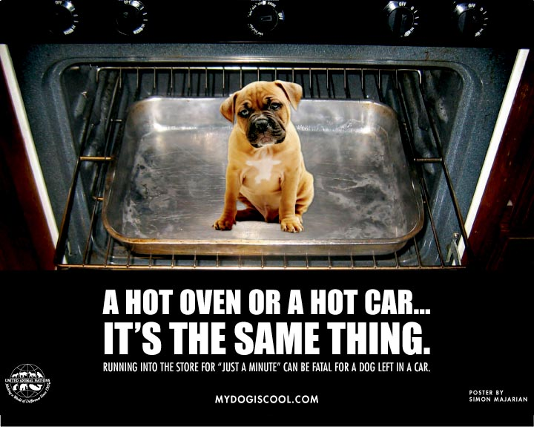

Slide 13
Guidelines for Preventing Heat-Related Disorders
Record athletes’ weight before and after practice
Weight loss in excess of 3% of body weight from sweating should be noted.
Observe for signs of heat exhaustion for those who lose more than 3 percent of their weight.
A loss of more than 7% of body weight means that the athlete should see a physician.

Slide 14
Guidelines for Preventing Heat-Related Disorders
Check the percentage of body fat for each athlete.
Athletes with a low percentage will be more likely to experience heat cramps.
Check the weather forecast before practice and competition.

Slide 15
Guidelines for Preventing Heat-Related Disorders
Be aware of the duration and intensity of practice in hot and humid weather.
Use acclimatization strategies.
Enable athletes to become accustomed to temperature and environmental conditions that may change between in- and off-season

Slide 16
Guidelines for Preventing Heat-Related Disorders
Select clothing in accordance with temperature and humidity.
Sweat-soaked shirts should be changed.
Athletes should avoid caffeine, alcohol, and carbonated beverages.
Be sure the athletes replenish every lost pound with 20 ounces of fluid.

Slide 17
Guidelines for Preventing Heat-Related Disorders
Thirst is not an adequate indicator for water needs during exercise.
Be sure athletes drink fluids before exercising:
17-20 ounces 2 to 3 hours before
7-10 ounces 10-20 minutes before

Slide 18
Guidelines for Preventing Heat-Related Disorders
During exercise.
Have athletes drink 7-10 ounces of fluid every 10-15 minutes.
Have water continually available.
Remind athletes that water from cold fluids empties from the stomach faster than water from warm fluids.

Slide 19
Guidelines for Preventing Heat-Related Disorders
Athletes should monitor the color and volume of their urine.
Light colored urine is normal.
Dark yellow urine with a strong odor means the athlete needs to drink more fluid.
Vitamins can change the color and odor of urine.

Slide 20
Guidelines for Preventing Heat-Related Disorders
An athlete with a fever is more susceptible to heat problems.
Fluids that athletes drink during practice should also be available at competitions.
Some sports drinks are better than water because they contain important electrolytes.

Slide 21
Guidelines for Preventing Heat-Related Disorders
Salt can be added to water or sports drinks at ½ teaspoon per one quart.
A well-balanced diet with limited fat consumption helps to prevent heat problems.
Be aware of the concern with “energy drinks” and what is in them.

Slide 22
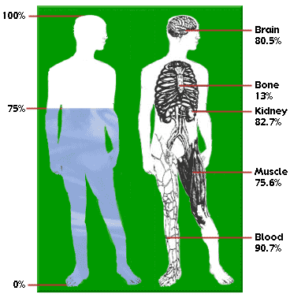
Preventing Heat Illness
Hydration
Athletes should always begin activities
in a well hydrated state
Urine
Light yellow in color (lemonade) = properly hydrated
Dark color in urine (cider) = dehydration
It is always important to space fluid intake out rather than trying to “cram” at last minute
Important to drink 17-20 fluid ounces of water prior to workout (2-3 hours)and 7-10 fluid ounces immediately before workout (10-20 minutes)

Slide 23
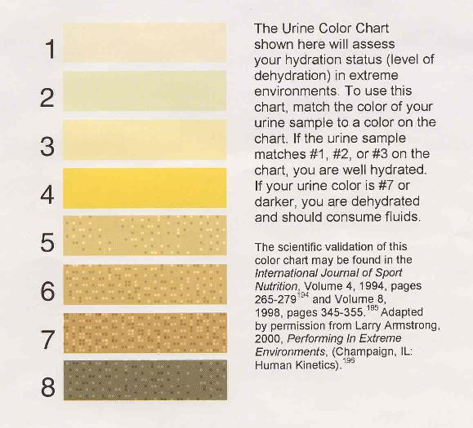
Urine Color Chart

Slide 24
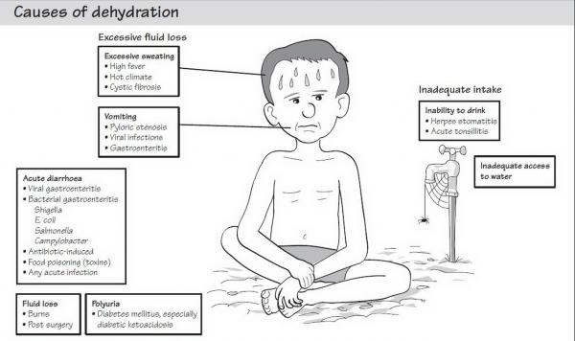
Dehydration
An athlete who does not replenish fluids is likely to become dehydrated
An individual is said to have mild dehydration when fluids lost are less than 2 % of normal body weight
Symptoms:
Thirst
Dry Mouth
Headache
Dizziness
Possibly cramps

Slide 25
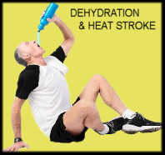
Fluid and Electrolyte Replacement
If the athlete ignores the thirst impulse and continues to work out, dehydration sets in
Many athletes only replace 50% of the water they lose through sweating, leaving their system in a deficit
Athletes must have unlimited access to fluids, both prior to, DURING and
after workouts

Slide 26
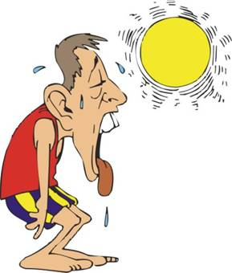
Ways to Prevent Heat Illness
Adequate access to water during workouts
Gradual Acclimatization
Identifying Susceptible Individuals
Who?????
Selecting Appropriate Uniforms
Monitoring the Heat Index
Heat Policy in place to protect the athletes

Slide 27
Possible Causes of Heat-Related Illness
Inadequate heat acclimatization
Inadequate fitness level
Higher body fat
Dehydration
Illness or fever
Salt deficiency
Presence of gastrointestinal distress
Inadequate meals

Slide 28
Possible Causes of Heat-Related Illness
Insufficient energy intake
Skin conditions
Ingestion of medications or dietary supplements
Overly motivated athletes
Athletes reluctant to report problems

Slide 29
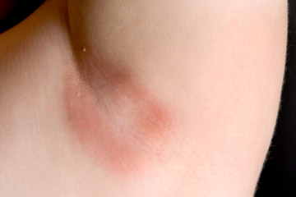
Recognizing and Managing Exertional Heat Illness
Heat Rash
Benign condition associated with a red, raised rash accompanied by sensations of prickling and tingling during sweating
Heat Syncope
Also called heat collapse
Associated with rapid physical fatigue during overexposure to heat
Treated by laying athlete down in a cool environment and replacing fluids

Slide 30
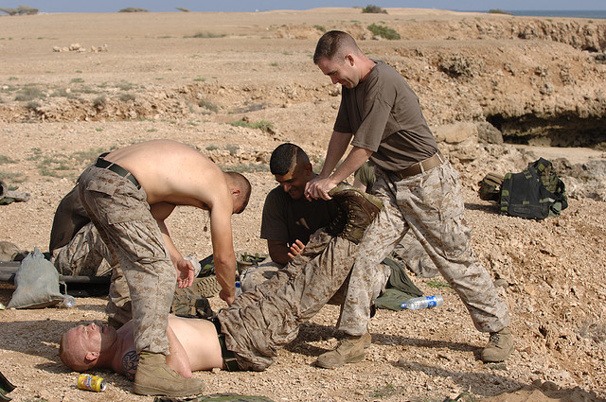
Recognizing and Managing Exertional Heat Illness
Exertional Heat Cramps
Muscle spasms, usually in the stomach or calf (not limited to those areas)
Related to excessive loss of water and electrolytes
Profuse sweating leads to imbalance within muscles, ultimately leading to extreme cramps
Prevented by adequate replacement of electrolytes
Immediate treatment is ingestion of large quantities of water, mild prolonged stretching with ice massage of muscle
High chance of reoccurrence, so usually leads to removal of additional workouts
for the remainder of the day

Slide 31
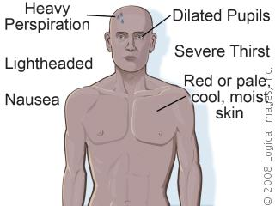
Recognizing and Managing Exertional Heat Illness
Exertional Heat Exhaustion
Occurs when an athlete becomes dehydrated to the point that the body is unable to sustain adequate cardiac output and cannot continue with workout
Body temperature (as gauged by rectal temperature) is less that 104 degrees
Must be immediately removed and taken to cool area
Legs elevated / cooling attempted / rehydration essential (IV if necessary)
If rapid improvement is not noticed, transport is necessary

Slide 32
Recognizing and Managing Exertional Heat Illness
Exertional Heatstroke
Serious, life threatening emergency
Body temperature rise affects CNS, body tissue, extreme circulatory and metabolic stresses occur as well as physiological dysfunction
Can occur suddenly without warning
Body temperature is recorded at 104 or higher
Hot skin and may have an absence of sweating
Body temperature must be lowered as fast as possible
Cold water bath
Cold towels
Must be transported as soon as possible

Slide 33
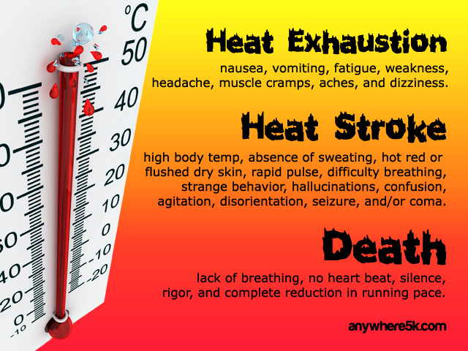

Slide 34
Environmental Cold Stress
Wind and moisture can complicate performance in cold weather.
Wind-chill factor
Effect of wind in cold temperatures
Velocity of wind cools the air, making temperatures even cooler than the thermometer reads
Precautions must be taken when participating in any cold-weather sport.

Slide 35
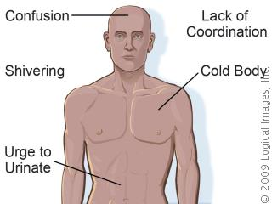
Hypothermia
Hypothermia – cold weather can
cause the body to lose temperature,
leading to medical emergencies
Low temperatures alone can cause problems, but when wind is added, chill factor is more of a concern
A third factor, dampness or wetness, further increases the chance of hypothermia

Slide 36
Prevention
Apparel must be geared to the weather
If damp, needs to be changed regularly
Proper warm up
Proper rehydration
Yes, you can get dehydrated in cold conditions

Slide 37
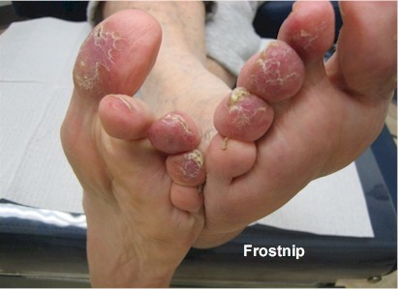
Common Cold Injuries
Frost Nip
Involved ears, nose, cheeks, chin, fingers and toes
Commonly occurs when there is a
High wind
Severe cold
Combination of the two
Can be treated with firm, sustained pressure (no rubbing), blowing hot breath or covering with warm clothes

Slide 38
Common Cold Injuries
Frostbite
Prolonged and constant exposure to the cold can cause issues in the fingers and the toes
Caused by issues in peripheral circulation and can be avoided by proper cover and removal from cold exposure
Superficial frostbite- involves only skin and subcutaneous tissue
Rewarming in warm water (101-110 degrees) will help with issues
Deep frostbite – Serious injury indicating tissues are frozen
Requires immediate hospitalization
Rapid rewarming is required
Possible loss of affected areas

Slide 39
Superficial Frostbite

Slide 40
Deep Frostbite

Slide 41
Lightning Safety
Number two causes of environmental deaths annually (responsible for 110 deaths per year)
Every institution must have a policy in place to deal with lightning
Policy must include:
Who monitors
Who makes decision to halt play
How long play is suspended
Where athletes and spectators are
moved during delay

Slide 42
Lightning
Know where the nearest shelter is and how long it takes to get there.
Flash-to-bang method
30/30 rule

Slide 43
Where to (and where not to) go
Yes
Indoors
Car
Ditch
Ravine
Valley
If lightning strikes around you, do not lie flat but rest in a crouched position

Slide 44
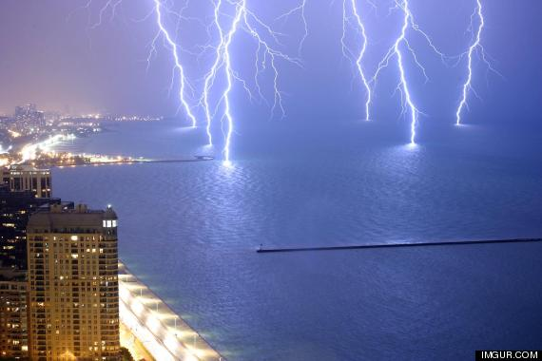
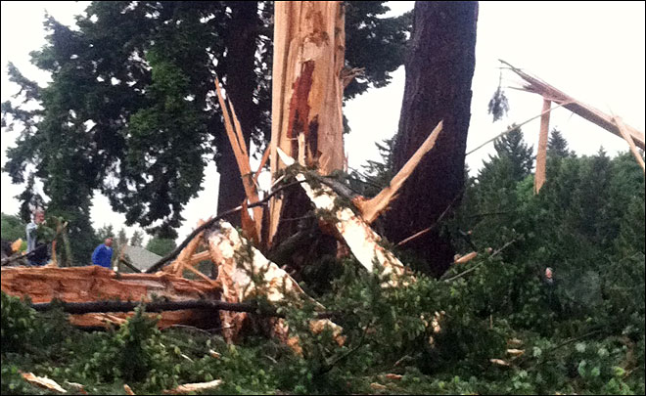
Where to (and where not to) go
No
Around a large tree, flagpole or light pole
Hill
Bleachers
Under an umbrella
Anywhere close to standing water

Slide 45
Flash to Bang
The most dangerous storms give little or no warning
Lightning is always accompanied by thunder, although 20 – 40 % of thunder is never heard
Flash-to-bang method provides an estimation of how far away lightning is occurring
When you see lightning, count the number of seconds until you hear thunder. At that point, divide by 5 and you have your mile estimation
Ex: 30 seconds between flash and bang = approx. 6 miles away
Policy = 30 seconds or less means play is suspended and shelter is found

Slide 46
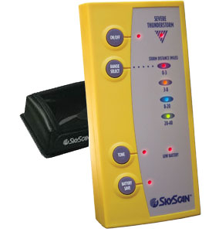
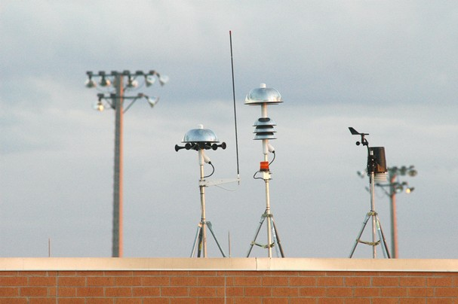
Electronic Lightning Detectors??
Some can detect lightning as far as 40 miles away
Are they accurate?
Electronic Overload
Stadium Lights
Cell Phones
Ipods
Wireless Internet
Golf Carts

Slide 47
Football Player Killed By Lightning Strike September 28, 2012
COCONUT CREEK, FL -- A High School football player in South Florida was killed after getting struck by lightning. Several others were hurt. 15-year-old Schaffner Noel was struck in the chest. He was taking part in a football game Wednesday afternoon between Monarch High School and Pompano High School. Another player and a cheerleader who were standing next to Noel, were hurt. Officials say they were hospitalized in serious but stable condition. They also say a police officer also fell down and ten other students were treated for cuts, bruises and abrasions. School officials said they had called off the football game when the storm began, and the students were coming off the field when the player was struck

Slide 48
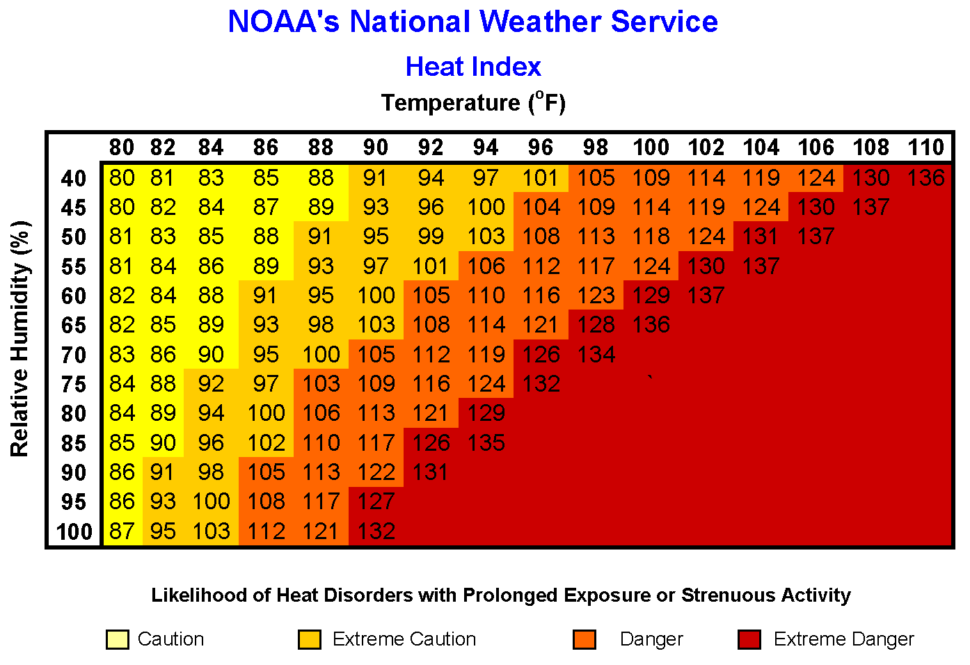
Air Pollution
Significant problem everywhere in the United States, but particularly in urban areas with large industries and heavy automobile traffic
Affects heat index
Affects athletes with asthma
Affects athletes with allergies

Slide 49
Skin Conditions in Athletes
Acne mechanica
Acne that results from heat, pressure, occlusion, and friction
Plantar warts
Small, hard growths on the bottom of the foot
Herpes gladiatorum
Herpes simplex infection transmitted through skin-to-skin contact

Slide 50
Skin Conditions in Athletes (cont’d.)
Fungal infections
Tinea pedis: fungal infection that thrives in warmth and dampness
Blisters
Friction, heat, and moisture increases risk
Tear occurs within upper skin layers, forming a space into which that fluid seeps

Slide 51
Skin Conditions in Athletes (cont’d.)
Abrasions
Normally caused by poorly fit equipment or rubbing of skin
Jogger’s nipples
Constant chafing between a runner’s nipples and shirt causes painful, crusted lesions that bleed

Slide 52
Diabetes
Disease in which the body does not produce or properly use insulin
A hormone needed to make cells absorb sugar from blood
Genetics and environmental factors (e.g., lack of exercise) appear to play roles

Slide 53
Diabetes (cont’d.)
Type 1 diabetes
Results from the body’s failure to produce insulin
Type 2 diabetes
Occurs when the body still makes insulin but:
Does so in insufficient amounts or
Produces insulin that does not function properly

Slide 54
Diabetes (cont’d.)
Diabetic emergencies
Insulin reaction
Occurs when there is too much insulin in the body
Diabetic coma
Occurs when there is too much sugar and too little insulin in the blood

Slide 55
Seizure Disorders
Disruptions of normal brain activity
Epilepsy: seizures recurr regularly
Other causes include:
Infections, high fever, brain tumors, drugs, strokes, bleeding in the brain, trauma to the brain, and low blood glucose, sodium, or calcium

Slide 56
Seizure Disorders (cont’d.)
Types:
Simple partial seizure
Jerking begins in one area of the body
Cannot be stopped, but person stays awake and aware
Generalized tonic-clonic seizures
Characterized by a sudden cry, falling, and rigidity, followed by muscle jerks, shallow breathing or temporarily suspended breathing, bluish skin, and possible loss of bladder or bowel control

Slide 57
Insect Bites and Stings
Two greatest risks:
Allergic reactions
Local
Systemic
Infections
Epinephrine injection is the only effective immediate treatment

Slide 58
The Female Athlete Triad
Combination of:
Disordered eating
Amenorrhea (lack of menstrual periods)
Osteoporosis

Slide 59
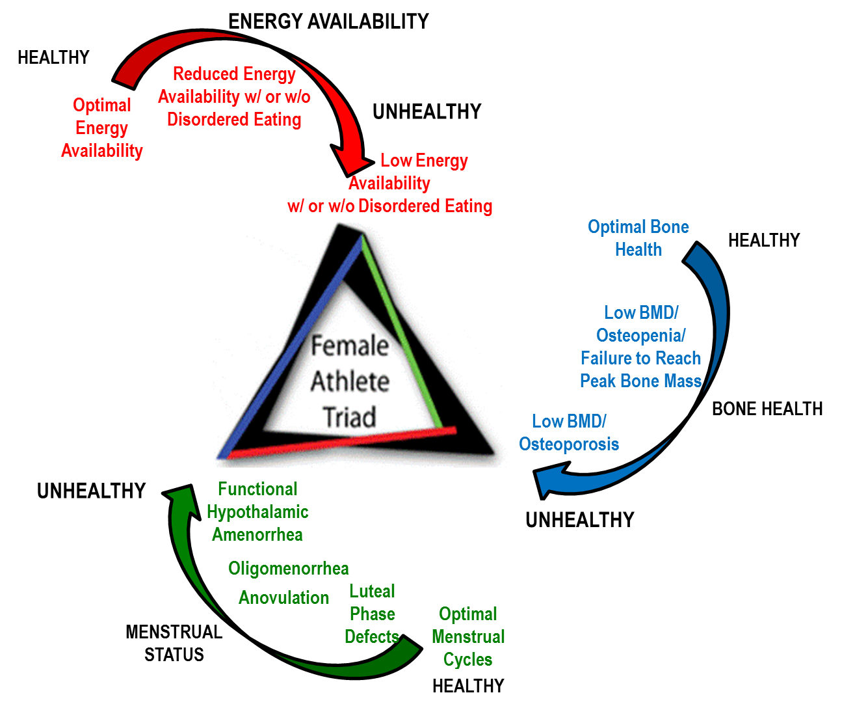

Slide 60
The Female Athlete Triad (cont’d.)
Warning signs:
Frequent or unexplained injuries
Excessive or compulsive exercise
Change in performance
Impaired concentration
Absent or irregular menstrual periods
Restrictive eating
Use of weight-loss products or supplements

Slide 61
Conclusion
Many health and safety factors that must be taken into account when participating in athletics
Factors (e.g., the environment) can turn a positive situation into a dangerous one
Understanding causes of environmental-related illnesses helps the athlete plan ahead and stay within safe limits

Slide 62
Conclusion (cont’d.)
Other concerns are specific medical conditions that may limit or curtail athletic competition
The athlete must be made aware of illnesses and conditions that can affect their performance and health
Quick recognition and treatment will ensure good health and optimal performance

